Slide 1





Let's Start

Slide 2

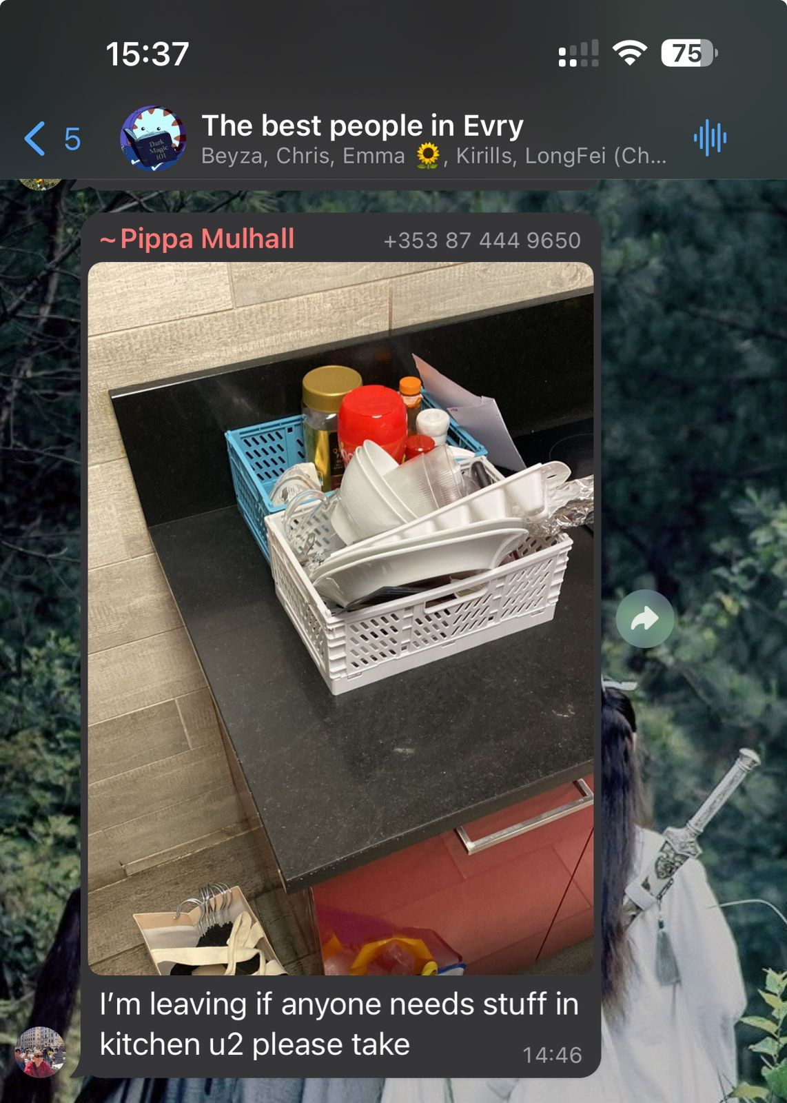
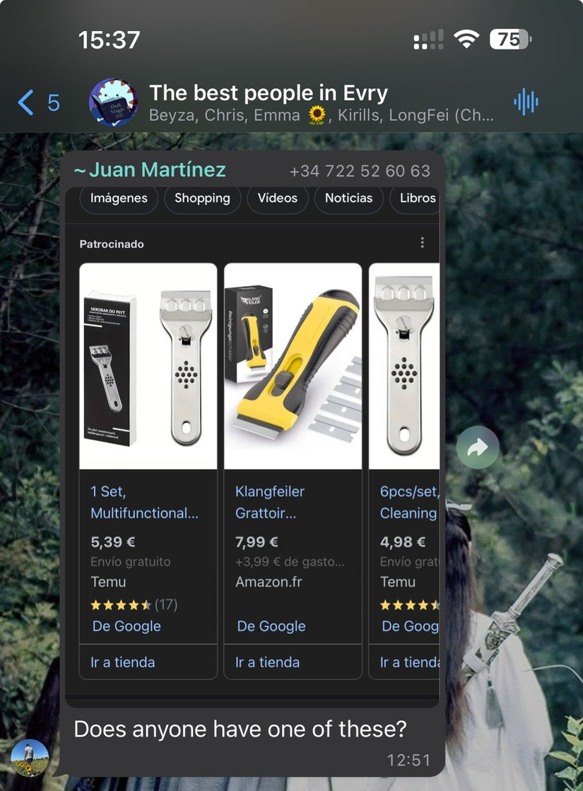
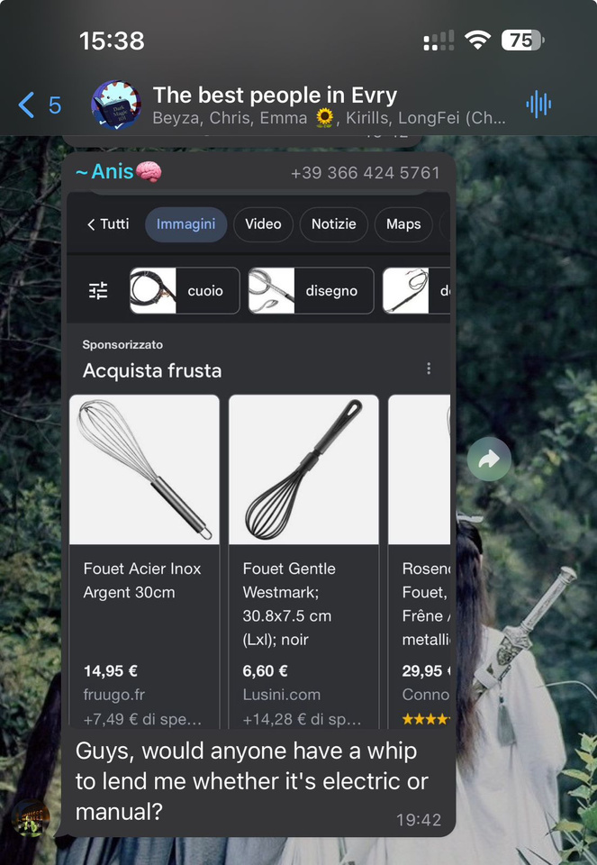
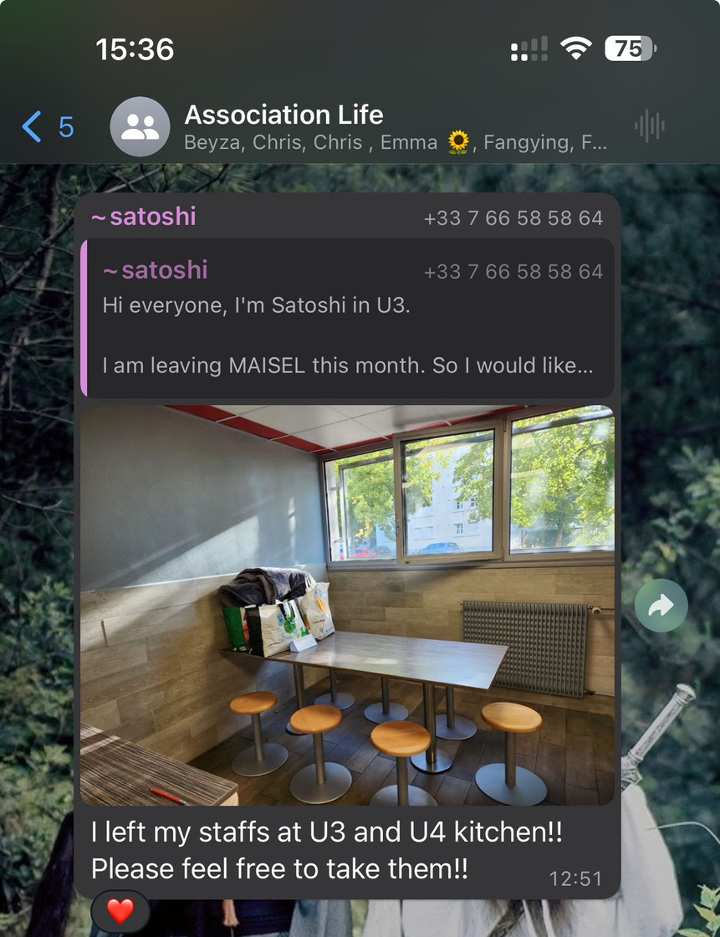
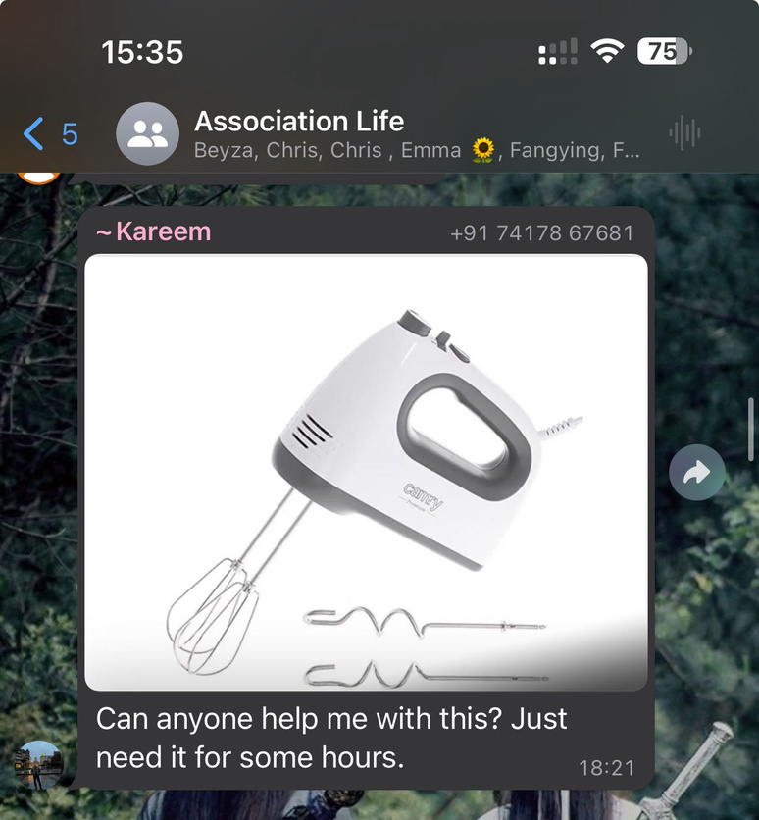

Slide 3

Solution:
Problem:
Problem:
Lending peer-to-peer platform which allows to rent needed items from the local community
High expenditures of the international exchange students on the items they need once or for a short periods of time
Issues with getting rid of the items when students leave that lead to overconsumption and waste

Slide 4

Evidence-Based Facts of The Problem
France saw a record rise in foreign students by 8% in 2021-2022 (Campus France, 2022).
Over 100,000 foreign students are enrolled in higher education establishments in Île-de-France (IAU, 2017).

Slide 5




Renting Platform Survey
Population of almost a 100 students.
Short-term stay in France.
Rented unfurnished places.
High expenditure on house equipment.
Interested in renting platform.

Slide 6
Solution

Slide 7
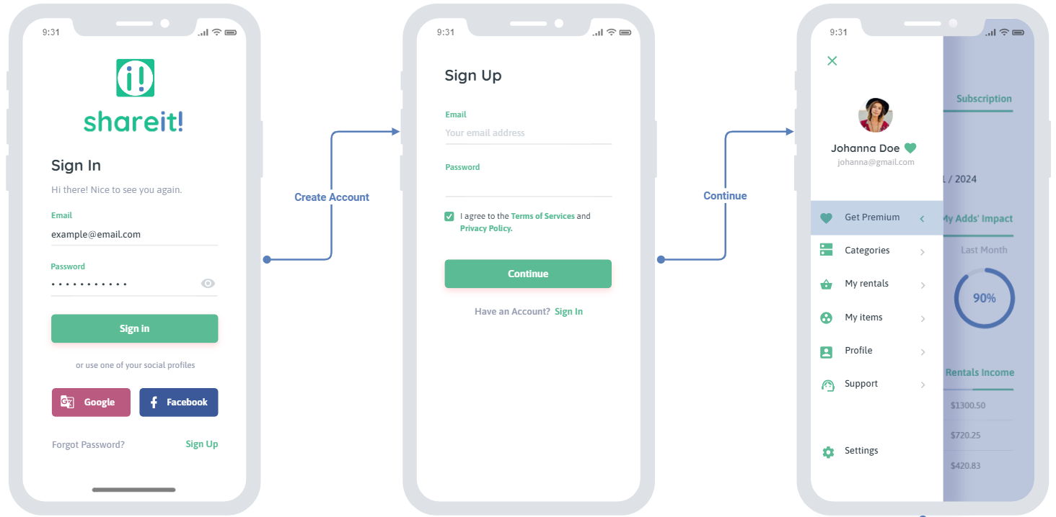
Link to our prototype.

Slide 8
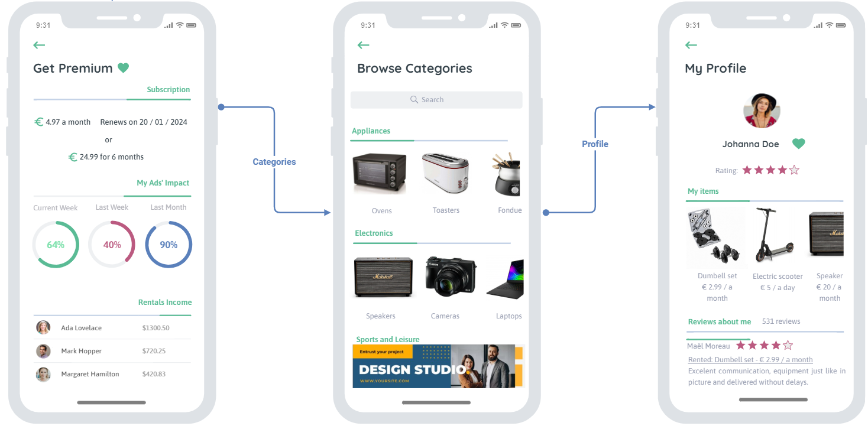
Link to our prototype.

Slide 9
Technical Roadmap
How will the app be developed? developed in-house at the beginning +
outsourcing QA, UX and UI as we grow.
Versions of the app released quarterly per year.
What about resources? €7000 of the challenge.
Seeking investment and offer shares of up to 3%.
Taking salaries until second year and loaning it
to the company.
Looking for sponsorship of startup incubators
such as Agoranov.

Slide 10
Launch Schedule - Year 1
Q3
Launch of the app in English and French for the Paris area.
Q1
Version 1.1: Pre-sign up.
Q2
Pilot version of the app.
Testing with students from different campuses.
Q4
3,824 rents by the end of the year.

Slide 11
Launch Schedule - Year 2
Q1
Version 5.2 with optimization of the UX and bug fixes.
Q3
Expansion of cloud services and storage. Expansion of our services to the Ile-de-France region.
Q2
Start seeking partnerships with institutions such as ESN.
Q4
5,736 rents by the end of the year.

Slide 12
Launch Schedule - Year 3
Q1
Expand the team with freelancers across France
Q3
Services of our app are extended to other major cities in France like Lyon and Nantes.
Q2
Go to marketing campaigns such as referral programs.
Q4
7,457rents by the end of the year.

Slide 13


Market
monthly rental expense
15 euro
3% of serviceable market
reachable

Slide 14
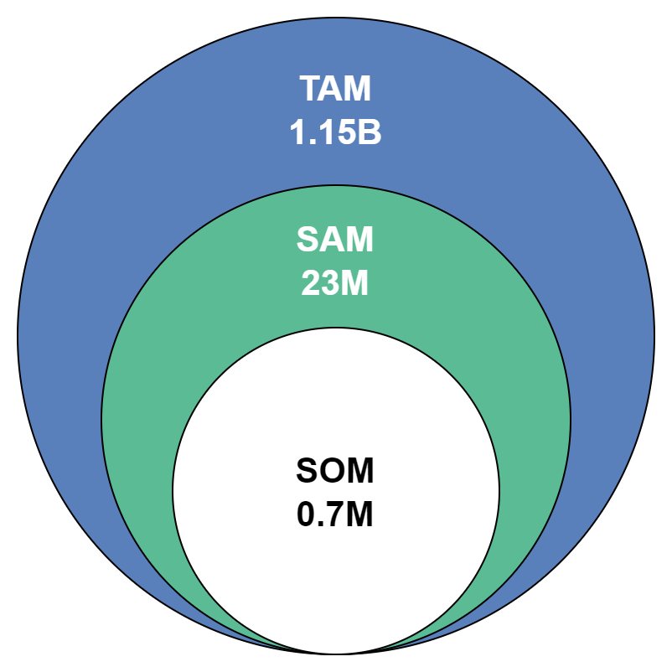
Market
Research-based estimation

Slide 15


Commercial launch
Year 1
SMM
4000 transactions inside the platform
Top 5 Institutions in Paris covered
ESN Partnership
Total marketing costs: 13.000 eur
STUDENT ORGANIZATIONS
Year 2-3
Annual increase of transactions by 50% annually
Сhannelization and partner network expansion
Annual marketing costs: 20.000 eur
PAID PROMOTIONS

Slide 16
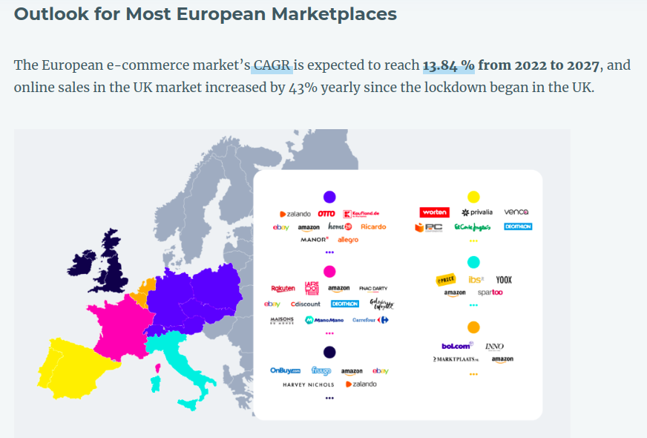
Competitive Environment
Is it fragmented or concentred?
With many companies in the sector, Euopean and French marketplaces are highly fragmented.

Slide 17
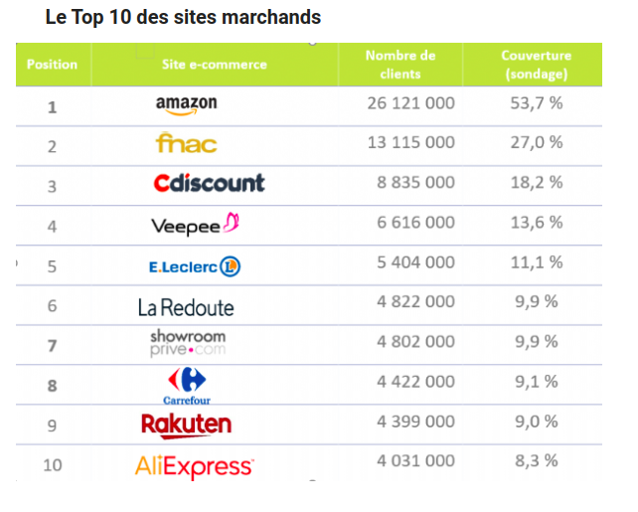
Competitive Environment
Direct or Indirect Competitors?
Mostly of the competitors are indirect they have the biggest roles in this market.
Ex: Amazon, Fnac, Leboncoin, Facebook Marketplace.
There are a few buisnesses that are direct competitors but they do not have huge markets.
Ex: Orent, Move & Rent, Loc and Roll

Slide 18
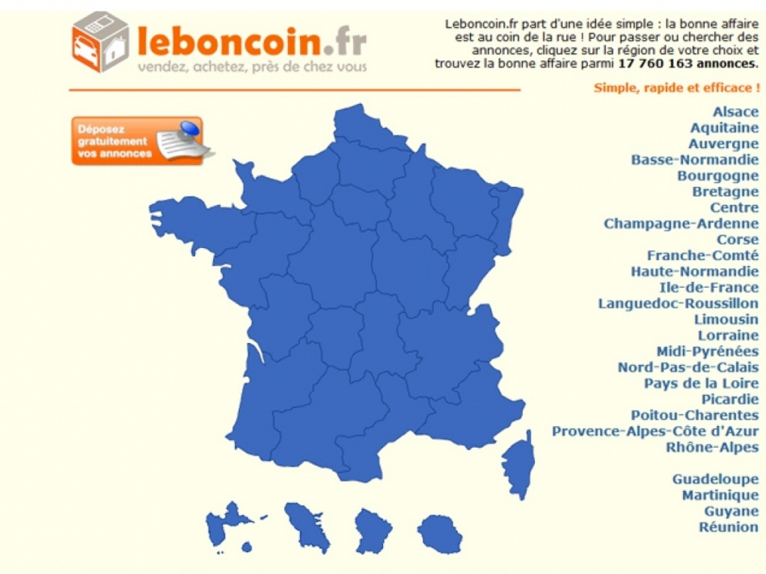
Competitive Environment
Main actors
Leboncoin
France’s biggest sales website
70% of french population has already browsed the website
LeBonCoin estimated at €3 billion
They sell everything cars, property, furniture, clothes, always P2P.
The platform generates revenue by monetizing visibility (ads), they do not charge for transactions

Slide 19

Competitive Environment
Main actors
Amazon
It’s leading the French e-commerce market, with e-commerce net sales of five $5 Billion and with 15 million monthly visitors
They sell many products: electronics, clothing, home goods. B2P and P2P
Makes money by charging sellers fees for every transaction and for posting theirs goods. They also got a subscription offer (Amazon Prime)

Slide 20

Competitive Environment
Main actors
FNAC DARTY
36 million Active customers
2nd French e-commerce destination
They sell of everything, they have their on shop but also a marketplace where you can buy second hand items.
They make money by offering a monthly subscription for sellers and by applying fees on transactions.

Slide 21

Competitive Environment
Main actors
Facebook Marketplace
1 billion monthly users worldwide
250 million sellers worldwide
They are a free listing commerce plataform, they don’t charge for transactions nor for posting items
Their source of money come from advertisements and from sellers wanting to boost their products
They sell everything (cars, electronics, clothes), but most of it are second hand items.

Slide 22










KEY PARTNERS
KEY ACTIVITIES
VALUE PROPOSITIONS
CUSTOMER RELATIONSHIP
CUSTOMER
SEGMENTS
Erasmus Student Network (ESN)
Student organizations within universities
Campus France
Platforms for renting accommodation (Studapart)
ISIC
Individuals looking to rent out their equipment
Delivery services
User Acquisition
Networking and marketing
Technical and customer support
Verification processes for item owners and payments
Cheaper options for the temporary needed items
Saving time on searching
Monetize unused items
Declutter living space
Sustainable environment
Community connection
Community engagement
Rating, Review, and Feedback
Seamless Support
International students coming to Île-de-France to take part in student mobilities
Residents want to rent out their equipment (locals, previous students, businesses)
KEY
RESOURCES
CHANNELS
Mobile App Platform (iOS, Android)
Website
Social Media Marketing
Partnerships with student organizations
Technology team
Network effect
Marketing strategies
BUSINESS MODEL CANVAS
COST STRUCTURE
REVENUE STREAM
Marketing and promotion
Platform maintenance and development
Salaries to employees
Administrative cost
Comission fee
Shipping fee
Premium account fee
Advertising

Slide 23
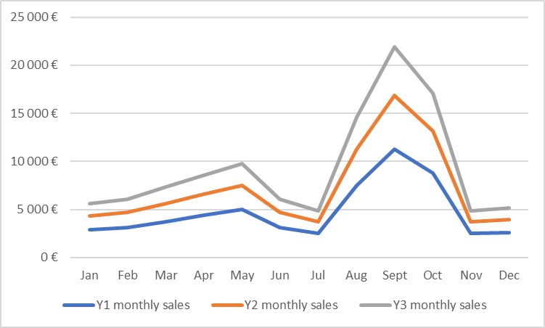
Sales
Total Sales
Year 1
57,360 €
Year 2
86,040 €
Year 3
111,852 €
Growth rate
y1 to y2 (%)
y2 to y3 (%)
50%
30%

Slide 24
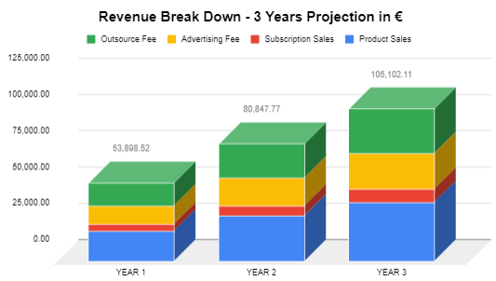
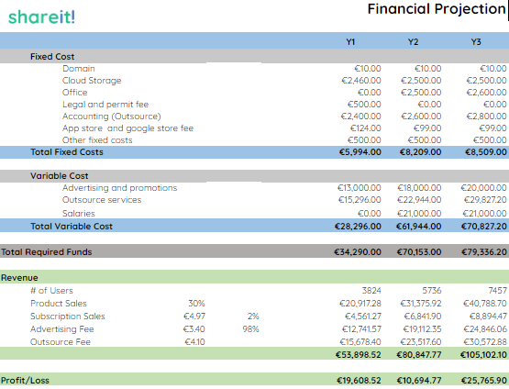
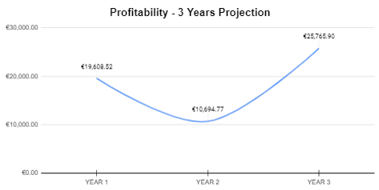
Financial Projections

Slide 25
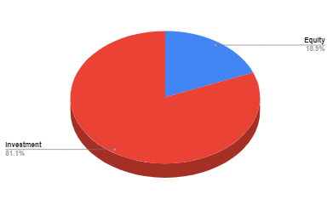
Financial Projections
€239,848.39
Total Revenue
€56,069.19
Total Net Profit
€183,779.20
Total Expense
7457
# of Transactions

Slide 26
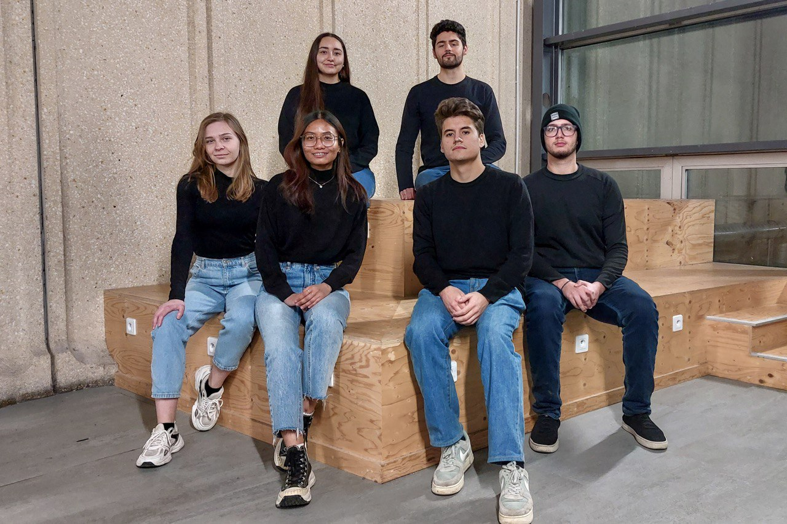
TEAM

Slide 27
INVEST IN US!
And let’s
together
30k€
information support and partnerships

Slide 28







THANK YOU!
"Live Beyond Limits: No Storage, Just Thriving with Our Rent-a-Lifestyle Solutions!"
contactus@shareit.com
shareit.com
The End

